Slide 1
CM2601 – OOAD
Lecture 02
Use Case Diagrams
Content created by Guhanathan Poravi

Slide 2

Agenda
To learn UML notation for creating use case diagrams

Slide 3
First: Elements of a Use Case Diagram
Use case diagrams have two useful properties
They show the things of interest to us
They show how these things are related

Slide 4
Parts of the model: Use Cases (Quatrani, 2005)
Use cases represent the processes and activities of the business and capabilities of the software
Use cases represent the client requirements of the system
Pay
Account

Slide 5
Parts of the model: Actors
Actors are external to the system
The system responds because an actor “interacts” on the system boundary = interface
Actors can be:
Roles
Other systems
Hardware devices
Customer

Slide 6
Relationships: Connecting things together
Association (between use cases and actors)
Include (between use cases)
Extend (between use cases)
Generalization (between use cases or between actors)

Slide 7
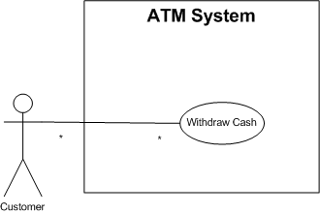
Association

Slide 8
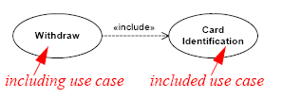
The «include» relationship
A relationship in which one use case (the base use case) includes the functionality of another use case (the inclusion use case)
A way to show the reuse of functionality
Important-notice the direction and style of the arrow

Slide 9
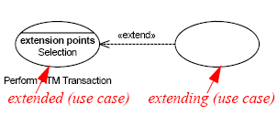
The «extend» relationship
Use when there is some additional behavior that should be added, possibly conditionally, to the behavior defined in another use case
Important-notice the direction and style of the arrow

Slide 10
Extension Points
An extension point is the point in a use case where another use case, which extends the functionality of the first use case, may or may not occur, depending on some condition.
An example might be the use case for paying for an item, which has an extension point at the payment type
Extending use cases may then extend at this point to pay by direct debit or credit card

Slide 11
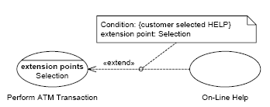
Extension Points
Or you could use a note if your software supports comments

Slide 12
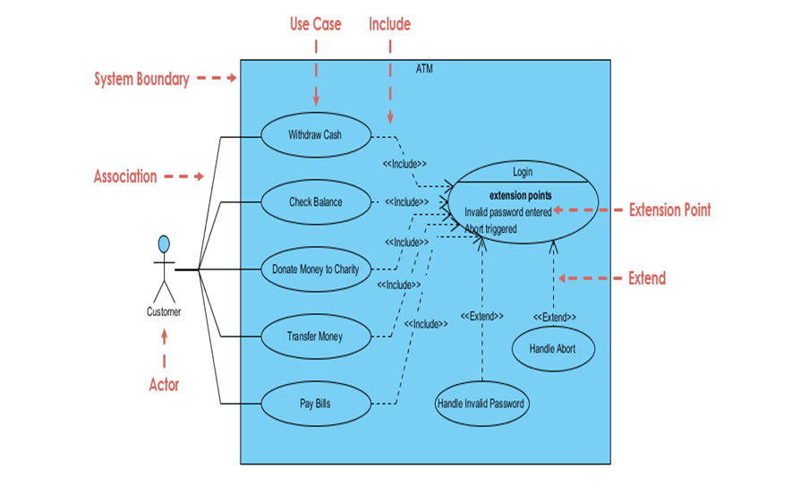
All in one

Slide 13
Generalization
A generalization relationship is one in which one model element (the child) is based on another model element (the parent)
The child receives all of the attributes, operations, and relationships that are defined in the parent
Note: We can generalize actors or use cases

Slide 14
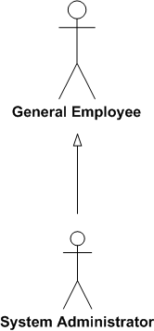
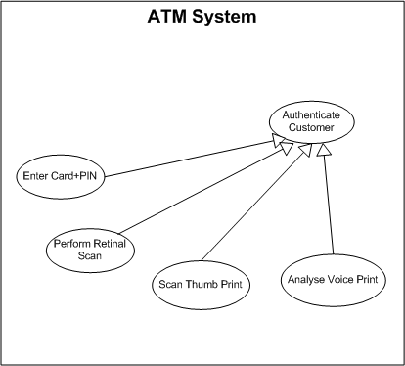
Generalization

Slide 15
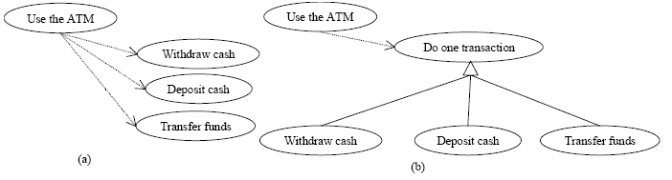
Generalization vs includes
Not the same

Slide 16
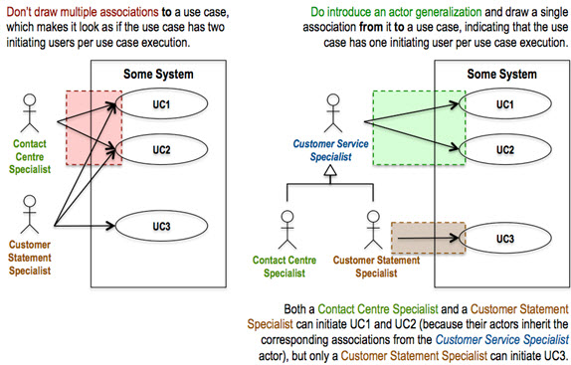
General advice

Slide 17
Naming use cases (Wirfs-Brock and Schwartz, 2001, p25)
Use concrete, “strong” verbs instead of generalized, weaker ones. Weak verbs may indicate uncertainty
Strong verbs: create, merge, calculate, migrate, receive, archive, register, activate
Weaker verbs: make, report, use, copy, organise, record, find, process, maintain, list
Strong nouns: property, payment, transcript, account
Weaker nouns: data, paper, report, system, form

Slide 18
References
Cockburn, A. (2000) Writing Effective Use Cases. Pre-publication draft.
OMG (2003). OMG Unified Modeling Language Specification version 1.5. Needham, MA: Object Management Group, Inc.
OMG (2007). OMG Unified Modeling Language Superstructure, V2.1.2. Needham, MA: Object Management Group, Inc.
Quatrani, T. (2005) Writing Good Use Cases. Presentation: IBM Software Group.
Wirfs-Brock, R. and Schwartz, J. (2001) The Art of Writing Use Cases. Presentation: Wirfs-Brock and Associates.

Slide 19

Questions

Slide 20
Next
Use Case descriptions

